Slide 1



ID Week, Philadelphia October 7-12 2014
Clinically Applied Variation in Replication Kinetics During Episodes of Post-Transplant Cytomegalovirus (CMV) Infections
I Lodding^{1,2}, H Sengeløv³, C Da Cunha-Bang^{1,3}, M Iversen⁴, L Vindeløv³, A Rasmussen⁵, F Gustafsson⁴, J GJ Downing¹, J Grarup¹, N Kirkby⁶, C Møller-Frederiksen¹, A Mocroft⁷, S Schwartz Sørensen⁸, JD Lundgren^{1,2}, on the behalf of the MATCH-programme study group
¹Centre for Health and Infectious Disease Research (CHIP); ²Department of Infectious Diseases; ³Department of Haematology; ⁴Department of Cardiology; ⁵Department of Surgery C; ⁶Department of Clinical Microbiology; ⁷University College of London, London, United Kingdom, ⁸Department of Nephrology; Rigshospitalet, Copenhagen, Denmark
Notes:
Clinical application of variation

Slide 2
Disclosures
None

Slide 3
Background
Cytomegalovirus (CMV) infection frequently complicates the course after solid organ transplantation (SOT) and human stem cell transplantations (HSCT)
Previous literature has established CMV as a rapidly replicating virus, with a doubling time of 1.3-2 days¹⁻³
The aim of the current pre-emptive strategy is to screen transplant recipients with CMV PCR with regular intervals in order to detect and treat infection before it causes clinical disease
The present guidelines recommend weekly screening intervals with CMV PCR for transplant recipients treated pre-emptively⁴
Emery, VC. et al, J. Exp. Med., 1999
Funch, GA. et al, Lancet Infect. Dis. 2007
Atabani, SF. et al, Am. J. Transpl. 2012
Kotton, CN. et al, Transplantation, 2013
Notes:
Screening reg interval in order to detect infection bef causes clinical disease

Slide 4
Aim of Study
To reproduce the previously reported CMV doubling time estimates
To evaluate the rationale for weekly screening intervals

Slide 5
Methods(I)
Patients
Consecutive SOT and HSCT recipients transplanted from January 2003 to August 2013 and who developed a first episode of post transplant CMV infection were included
Patients with pre-transplant CMV IgG serostatus Donor(D)-/ Recipient (R)- where excluded
CMV
Infection was defined as ≥2 CMV PCR samples ≥ 300 copies/mL, or one ≥ 3,000 copies/mL*
Symptomatic CMV infection was reviewed for all patients from journal records
*Using the Roche Amplicor PCR kit; 300 copies/mL corresponds to 273 IU/mL
Notes:
First CMV infection
Roche Amplicor
IU/mL

Slide 6
Methods(I) contd.
Patients were categorised according to pre-transplant D/R CMV
IgG serostatus as:
High risk (if D+/R- for SOT, or D-/R+ for HSCT)
Intermediate risk (if D+/R+)
Low risk (if D-/R+ for SOT and D+/R- for HSCT)
419 infectious episodes fulfilled these criteria

Slide 7
Methods (II): Example of Calculation of Doubling Time and Adjusting for Anti-CMV Treatment

Slide 8
Methods (II): Example of Calculation of Doubling Time and Adjusting for Anti-CMV Treatment
V₁,t₁

Slide 9
Methods (II): Example of Calculation of Doubling Time and Adjusting for Anti-CMV Treatment
V_{peak},t_{peak}
V₁,t₁

Slide 10
Methods (II): Example of Calculation of Doubling Time and Adjusting for Anti-CMV Treatment
time frame used for calculation of doubling time
V_{peak},t_{peak}
V₁,t₁
∆ t_{peak} t₁ ≤ 14 days

Slide 11
Methods (II): Example of Calculation of Doubling Time and Adjusting for Anti-CMV Treatment
Growth rate: (V_{peak}- V₁)/(t_{peak}- t₁)
Doubling time: ln2/Growth Rate
time frame used for calculation of doubling time
V_{peak},t_{peak}
Doubling time
V₁,t₁
∆ t_{peak} t₁ ≤ 14 days
* As previously described by Atabani and Emery

Slide 12
Methods (II): Example of Calculation of Doubling Time and Adjusting for Anti-CMV Treatment
Growth rate: (V_{peak}- V₁)/(t_{peak}- t₁)
Doubling time: ln2/Growth Rate
time frame used for calculation of doubling time
V_{peak},t_{peak}
Doubling time
V₁,t₁
∆ t_{peak} t₁ ≤ 14 days
Out of 419 infectious episodes, 193 episodes fulfilled these criteria
* As previously described by Atabani and Emery

Slide 13
Methods (II): Example of Calculation of Doubling Time and Adjusting for Anti-CMV Treatment
Growth rate: (V_{peak}- V₁)/(t_{peak}- t₁)
Doubling time: ln2/Growth Rate
time frame used for calculation of doubling time
V_{peak},t_{peak}
Doubling time
V₁,t₁
Initiation of anti-CMV treatment
∆ t_{peak} t₁ ≤ 14 days
Out of 419 infectious episodes, 193 episodes fulfilled these criteria
* As previously described by Atabani and Emery

Slide 14
Methods (II): Example of Calculation of Doubling Time and Adjusting for Anti-CMV Treatment
Growth rate: (V_{peak}- V₁)/(t_{peak}- t₁)
Doubling time: ln2/Growth Rate
time frame used for calculation of doubling time
V_{peak},t_{peak}
proportion of time used for calculation of doubling time covered with anti-CMV treatment
Doubling time
V₁,t₁
Initiation of anti-CMV treatment
∆ t_{peak} t₁ ≤ 14 days
Out of 419 infectious episodes, 193 episodes fulfilled these criteria
* As previously described by Atabani and Emery

Slide 15
Methods (III): Statistical Analyses
The estimated doubling times were explored using standard descriptive statistics, including correlation analyses and Mann Whitney U test
The estimated doubling times were adjusted for administration of anti-CMV treatment
A mathematical simulation was performed, in order to determine the optimal screening interval for pre-emptive treatment
Notes:
Jonathans arbejde: mathematical simulation på baggrund for estimeret dt og risk af emergence

Slide 16
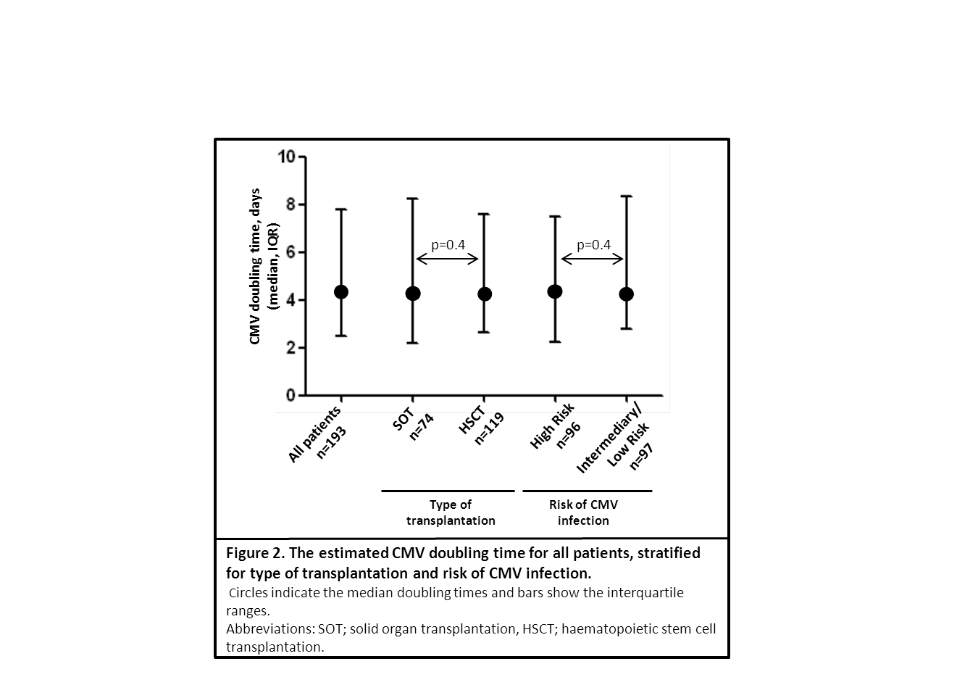
Results: CMV Doubling Time
Overall median doubling time; 4.3 (IQR 2.5-7.8) days
  No significant differences in doubling time detected when adjusting for
  type of transplantation
  risk of CMV infection according to donor/recipient CMV IgG status
  use of anti-CMV treatment
Notes:
iQR
Medication = 0 did not affect the CMV PCR

Slide 17
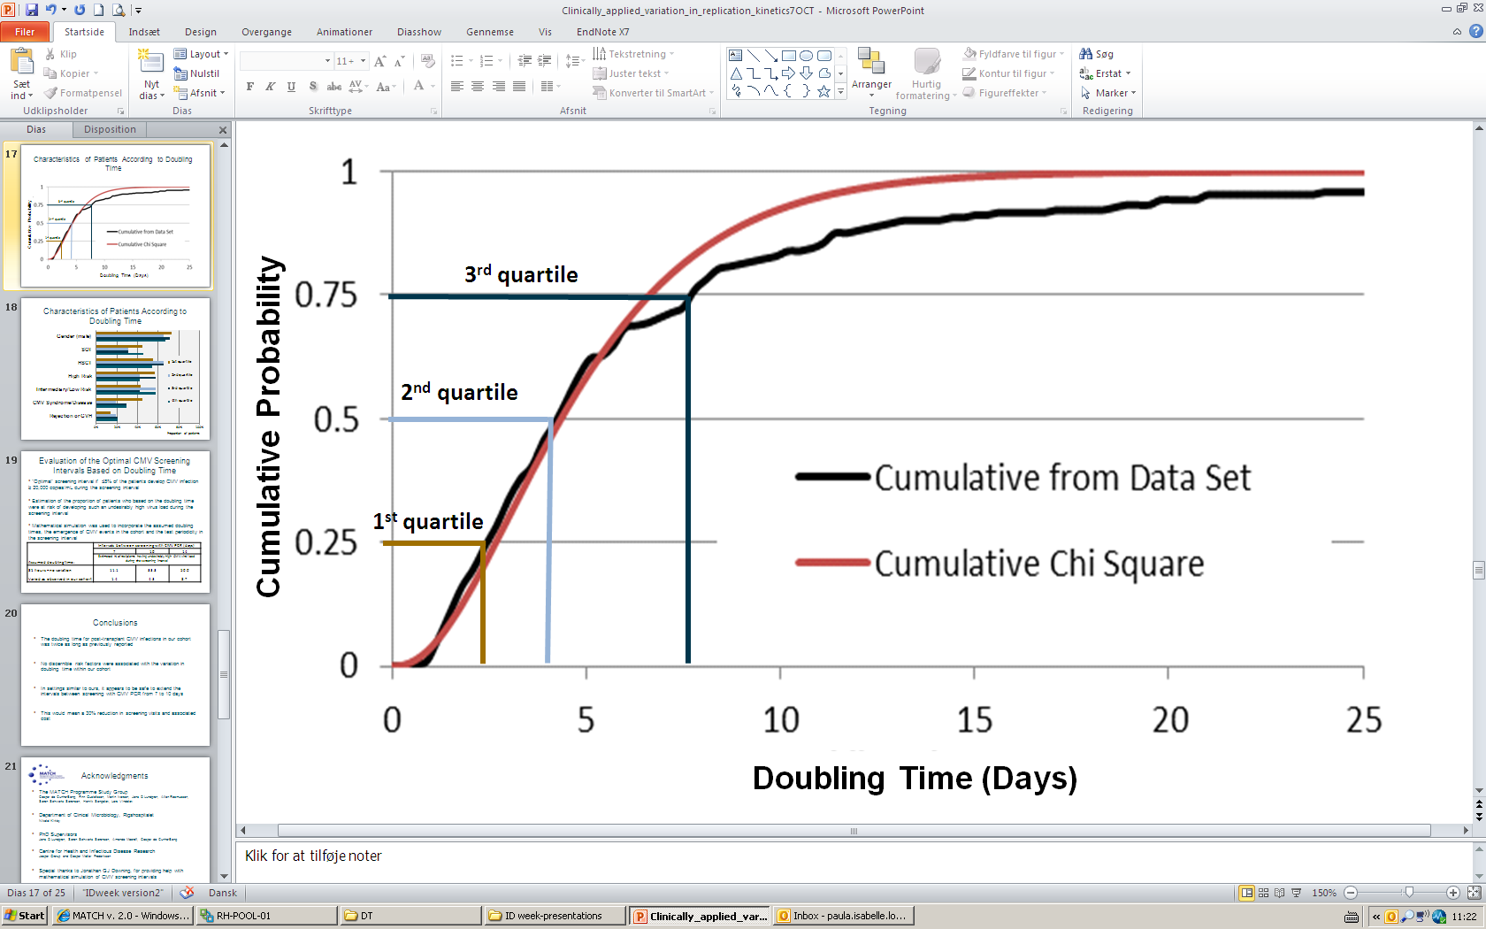
Characteristics of Patients According to Doubling Time

Slide 18
Characteristics of Patients According to Doubling Time

Slide 19
Evaluation of the Optimal CMV Screening Intervals Based on Doubling Time
“Optimal” screening interval if ≤5% of the patients develop CMV infection ≥ 20,000 copies/mL during the screening interval
Estimation of the proportion of patients who based on the doubling time were at risk of developing such an undesirably high virus load during the screening interval
Mathematical simulation was used to incorporate the assumed doubling times, the emergence of CMV events in the cohort and the test periodicity in the screening interval
Assumed doubling time: | Intervals between screening with CMV PCR (days)
 | 7 | 10 | 14
 | Estimated % of recipients having undesirably high CMV viral load during the screening interval
31 hours – no variation Varied as observed in our cohort | 11.1 1.4 | 33.3 4.3 | 50.0 8.7

Slide 20
Conclusions
The doubling time for post-transplant CMV infections in our cohort was twice as long as previously reported
No discernible risk factors were associated with the variation in doubling time within our cohort
In settings similar to ours, it appears to be safe to extend the intervals between screening with CMV PCR from 7 to 10 days
This would mean a 30% reduction in screening visits and associated cost
Notes:
The clinicians are provided with an arbitary choice of

Slide 21


Acknowledgments
The MATCH Programme Study Group
Caspar da Cunha-Bang, Finn Gustafsson, Martin Iversen, Jens D Lundgren, Allan Rasmussen, Søren Schwartz Sørensen, Henrik Sengeløv, Lars Vindeløv
Department of Clinical Microbiology, Rigshospitalet
Nikolai Kirkby
PhD Supervisors
Jens D Lundgren, Søren Schwartz Sørensen, Amanda Mocroft, Caspar da Cunha-Bang
Centre for Health and Infectious Disease Research
Jesper Grarup and Casper Møller Frederiksen
Special thanks to Jonathan GJ Downing, for providing help with mathematical simulation of CMV screening intervals

