Slide 1
Partner Study
Partners of people on ART: a New Evaluation of the Risks (PARTNER study)

Slide 2
Study overview
Funded by: The National Institute of Health Research (NIHR) in England
Sponsored by: UCL – University College London
Conducted by: UCL and CHIP - Copenhagen HIV programme

Slide 3
National Coordinators
Dr Armin Rieger, Austria
Prof Nathan Clumeck, Belgium
Dr Lars Mathiesen, Denmark
Dr Matti Ristola, Finland
Dr Christian Pradier, France
Dr Jan Van Lunzen, Germany
Dr Gráinne Courtney, Ireland
Prof Antonella d'Arminio Monforte, Italy
Prof Francisco Antunes, Portugal
Dr Vincente Estrada, Spain
Dr Katarina Westling, Sweden
Prof Pietro Vernazza, Switzerland
Prof JM Prins, The Netherlands
Dr Alison Rodger, UK
Sites as of Sep. 2011: 65

Slide 4
The data that PARTNER study will provide
HPTN 052 trial
The trial clearly indicates that risk of transmission between serodifferent heterosexuals is very low when the seropositive patient is on ART. However we do not yet know how many couples used condoms consistently so we do not yet know from the trial (or from other studies) exactly what is the estimated transmission rate during unprotected sex
Which is what we are studying in PARTNER.
- It seems likely that based on the results of 052 more couples will have sex without condoms.
- we urgently need more prospective observational data that will help to know exactly how low is the transmission risk under fully suppressive cART. In particular, we need data for gay men: we know transmission risks are different for anal sex.

Slide 5
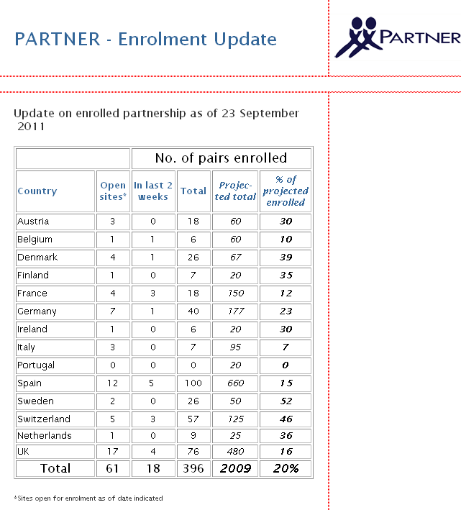

Slide 6
PARTNER Aim
Objectives
  1. To study the risk of HIV transmission to HIV negative partners. Enrolled couples are partnerships that continue not to use condoms consistently and the HIV-positive partner is on therapy (with a viral load < 50 copies/mL)
  2. To study why some partnerships do not use condoms. The study will also look at the proportion who begin to adopt consistent condom use, and factors associated with this.

Slide 7
Inclusion criteria for the sero-different pair
On ART (regardless of viral load)
Age > 18
Has an HIV negative partner
Partners have had sex without condom (penetrative anal or vaginal intercourse) together in the past month
Partners expect to have sex together again
Blood sample from both partners in case of transmission
Exclusion
  Pregnancy (only at enrolment)

Slide 8
Both partners will be seen at least every 4-6 months
The HIV positive partner : can have the questionnaires given to them at their regular clinic follow up visit
The HIV negative partner: min. 2 visit pr. year incl. HIV test and questionnaires
The partners do not have to attend study visits together

Slide 9
Sample size
Aim to recruit and follow sufficient number of partnerships in order to collect a total of 3,333 persons-years of prospective follow-up. Initially, 1650 partnerships will be identified, with the intention to follow them for 2 years. If for any reason a partnership chooses/is unable to contribute for the entire length of time, replacement will occur to achieve the overall target of 3,333 person-years.
Anonymization of data
Data on partnerships will be anonymized de-linked at intervals after the partnership is no longer under follow-up,including for partnerships where the HIV- person becomes infected.
In such cases, virus from the HIV+ and (formerly) HIV-person will be compared after anonymization.

Slide 10
Analysis
The primary analysis will be estimation of the rate of infection in partners per person year of unprotected sex partnership where the index patient has viral load <50 c/mL, excluding new infections that are shown to be phylogentically distinct from the HIV positive partner’s virus; i.e. transmission has not been from the HIV positive partner.
This will be calculated as the number of infections identified at the end of eligible periods divided by the sum of the person time over eligible periods (see below for definition of eligible periods).

Slide 11
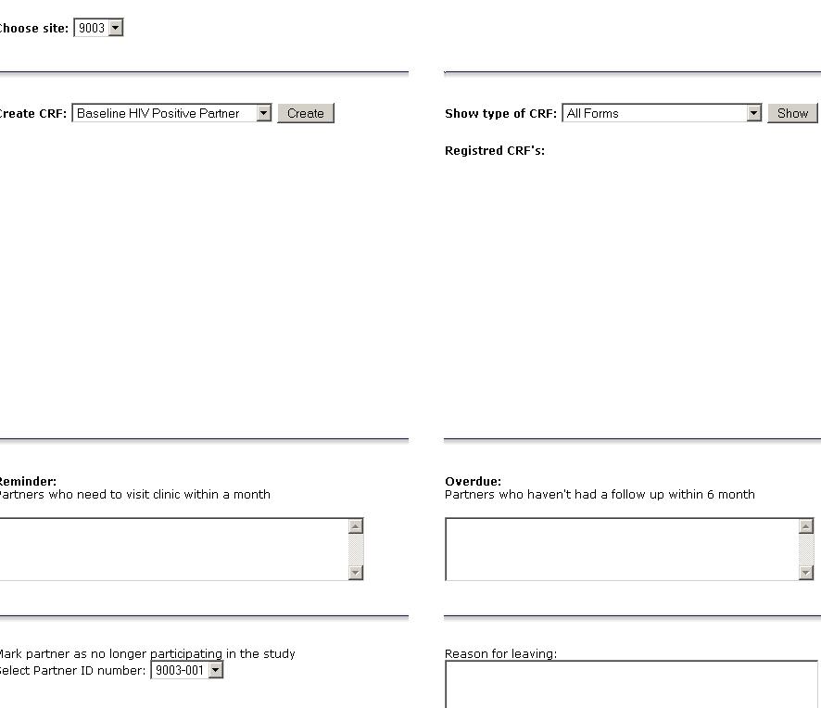
Case Report Forms (CRFs)
Enrolment and Follow-up CRFs entered online

Slide 12
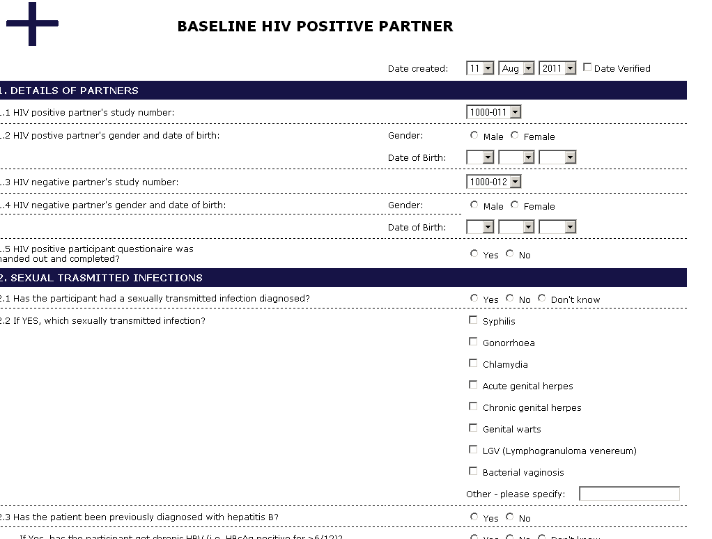
Example of enrolment CRF

Slide 13
Introducing the study to potential participants

Slide 14
Why is this study important?
Even with recent studies on transmission (The Swiss statements 2008 and HPTN052, 2011) we are still lacking important information about HIV transmission risk
Especially lacking is information about risk reduction in gay partnerships
Lacking also information about condom use and sexual behaviour in relation to transmission risk
The PARTNER study will attempt to answer these question
  to improve the information to HIV positive people and their sexual partners and ,
  to improve treatment strategies

Slide 15
Strategies for enrolling pairs at site
    Start with asking if they have an HIV negative partner
    If yes, give a VERY short introduction to the PARTNER study and refer to the research nurses/staff
    It is recommended for the study nurse to inquire about sex without condom and other inclusion criteria. Some HIV positive people may not feel comfortable discussing this with their physician.

Slide 16
Presenting the study
    We are looking for sero-different couples
    The study aims are to understand transmission risk
    ART lowers the transmission risk
    We know that some sero-different pairs are not always having sex with condoms
    You have the opportunity to participate in the study at this clinic
    There are over 400 pairs currently enrolled
    Would you like to know more about the study?

Slide 17
Presenting the study
  Inclusion criteria:
    Do you have a negative partner?
    Provide them with the information pamphlet
    Has the couple had sex without a condom once in the last month?
      (If they forgot to use a condom, and occasionally forget, that also meets inclusion)
  Present the visit and the questionnaires
    Questionnaires are anonymous
    HIV positive partner does not have to come more than usual
    HIV negative partner needs to visit twice a year (or max 4 visits in 2 years)

