Slide 1
Andreas A. Rostved, MD
Research assistant
Department of Surgical Gastroenterology and Transplantation
Rigshospitalet – Copenhagen University Hospital
Denmark
I have no financial relationships to disclose within the past 12 months relevant to my presentation.
My presentation does not include discussion of off-label or investigational use.
I do not intend to reference unlabeled/unapproved uses of drugs or products in my presentation.

Slide 2
Post-Transplant MELD Score Predicts Mortality and Re-Transplantation Among Liver Transplant Recipients
Andreas A. Rostved, Allan Rasmussen - Department of Surgical Gastroenterology and Transplantation, Rigshospitalet – Copenhagen University Hospital, Denmark
Lars Peters, Caspar Da Cunha-Bang, Jens D. Lundgren – CHIP, Department of Infectious Diseases and Rheumatology, Rigshospitalet – Copenhagen University Hospital, Denmark

Slide 3
Introduction
Within the first year after liver transplantation (LTx) 10-15 % die or are re-transplanted [1].
Early warning indicators after transplantation of poor outcome is lacking but would facilitate more rational risk stratification management and could further assist in understanding the processes around the transplantation leading to poor outcome.
The Model of End-stage Liver Disease (MELD) score is used to prioritize patients on waiting list and preliminary data also suggest that post-LTx MELD scoring is associated with short-term 3-month mortality [2, 3].
Further validation of the independent predictive ability of MELD scores in the first few weeks after LTx on long-term outcome has yet to be established.
Kim, W.R., et al., OPTN/SRTR 2012 Annual Data Report: liver. Am J Transplant, 2014. 14 Suppl 1: p. 69-96.
Wagener, G., et al., Predicting early allograft failure and mortality after liver transplantation: the role of the postoperative model for end-stage liver disease score. Liver Transpl, 2013. 19(5): p. 534-42.
Wong, C.S., et al., Scoring short-term mortality after liver transplantation. Liver Transpl, 2010. 16(2): p. 138-46.

Slide 4
Objective
Our aim was to evaluate early continuous post-LTx measurements of the MELD score as an early independent prognostic factor for 1-year mortality or re-transplantation.

Slide 5
Methods
Single center retrospective observational study
All adult liver transplant recipients from DBD were included from January 2007 to October 2013.
MELD was determined prior to, and daily from day 1-35 post-LTx.
Kaplan Meier analysis was used to estimate the proportion of patients in different MELD quartiles with graft failure.
The prognostic performance of MELD to predict 1-year all-cause death or re-LTx (graft failure) was estimated by AUROC analysis.
A multivariate Cox analysis was used to investigate risk factors for graft failure.
Notes:
Definition af graft failure

Slide 6
General characteristics
 | All patients n = 254 | Survivors n = 216 (85%) | Graft failure n = 38 (15%)
Age, median years (IQ range) | 51 (42-59) | 50 (42- 58) | 57 (47-62)
Male (%) | 151 (59 %) | 125 (58 %) | 26 (68 %)
Body mass index, median (IQ range) | 25 (22-29) | 25 (22-29) | 25 (22-29)
AB0 compatible non-identical, n (%) | 27 (11 %) | 17 (8 %) | 10 (26 %)
Pre-transplant MELD ≥35, n (%) | 24 (9 %) | 16 (7 %) | 8 (21 %)
Primary liver disease, n (%)
Autoimmune liver disease | 76 (30 %) | 73 (34 %) | 3 (8 %)
Chronic viral disease | 19 (7 %) | 12 (6 %) | 7 (18 %)
Fulminant hepatic failure | 30 (12 %) | 24 (11 %) | 6 (16 %)
Prior LTx | 11 (4 %) | 7 (3 %) | 4 (11 %)
Donor age, median years (IQ range) | 53 (40-61) | 52 (39-60) | 54 (44-64)
Cold ischemia, median minutes (IQ range) | 641 (530-774) | 634 (525-763) | 690 (563-835)
ET-Donor Risk Index, median (IQ range) | 1.7 (1.4-1.9) | 1.6 (1.3-1.9) | 1.8 (1.5-2.0)
Notes:
Husk at fortæl hvor mange vi inkluderer og hvor mange der dør

Slide 7
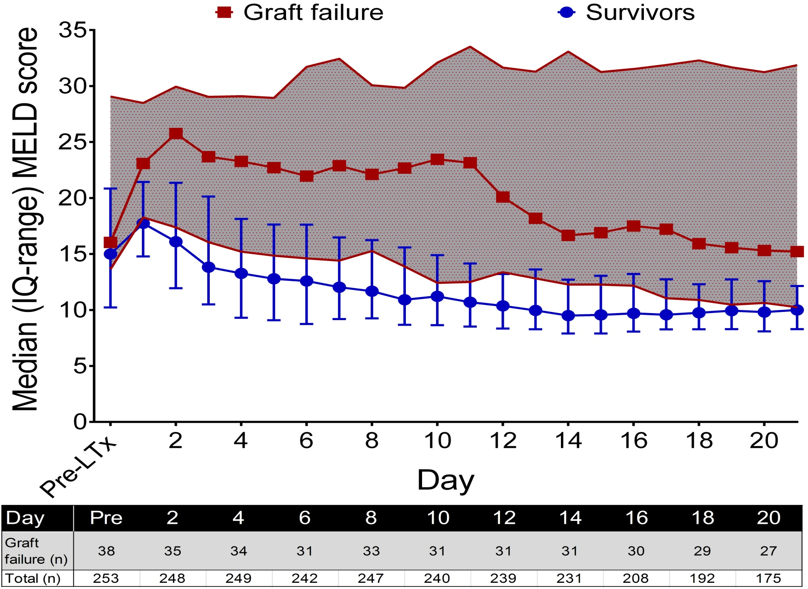

Kinetics of the MELD score
Notes:
Nævn at pre-LTx MELD er den samme.

Slide 8
Kaplan-Meier estimates of graft failure according to quartiles of MELD at 10 days after LTx
Notes:
Alle dødsfald i høj MELD score. Få dødsfald i lav MELD score.

Slide 9
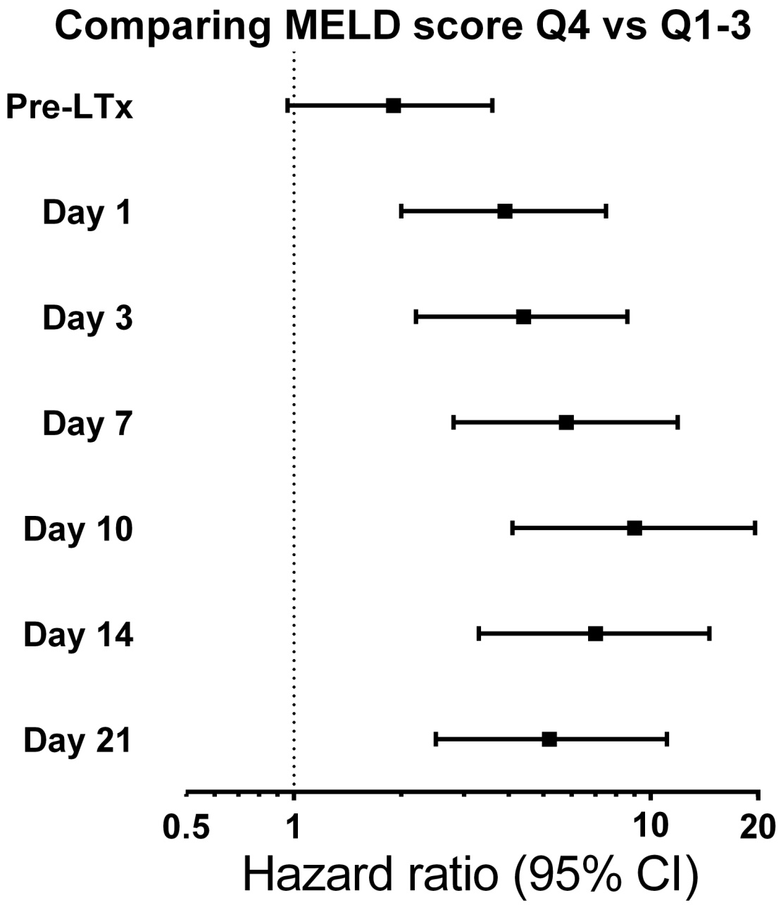
The post-LTx MELD score has a good discriminatory performance
AUROC (95% CI) | Sensitivity | Specificity
0.60 (0.50 - 0.70) | 37.8 | 77.2
0.70 (0.60 - 0.80) | 52.8 | 80.3
0.75 (0.66 - 0.83) | 55.9 | 80.0
0.79 (0.71 - 0.87) | 61.3 | 80.9
0.80 (0.72 - 0.89) | 71.0 | 81.8
0.80 (0.71 - 0.89) | 64.5 | 81.5
0.75 (0.64 - 0.86) | 57.1 | 80.9
Notes:
Påfaldende at

Slide 10
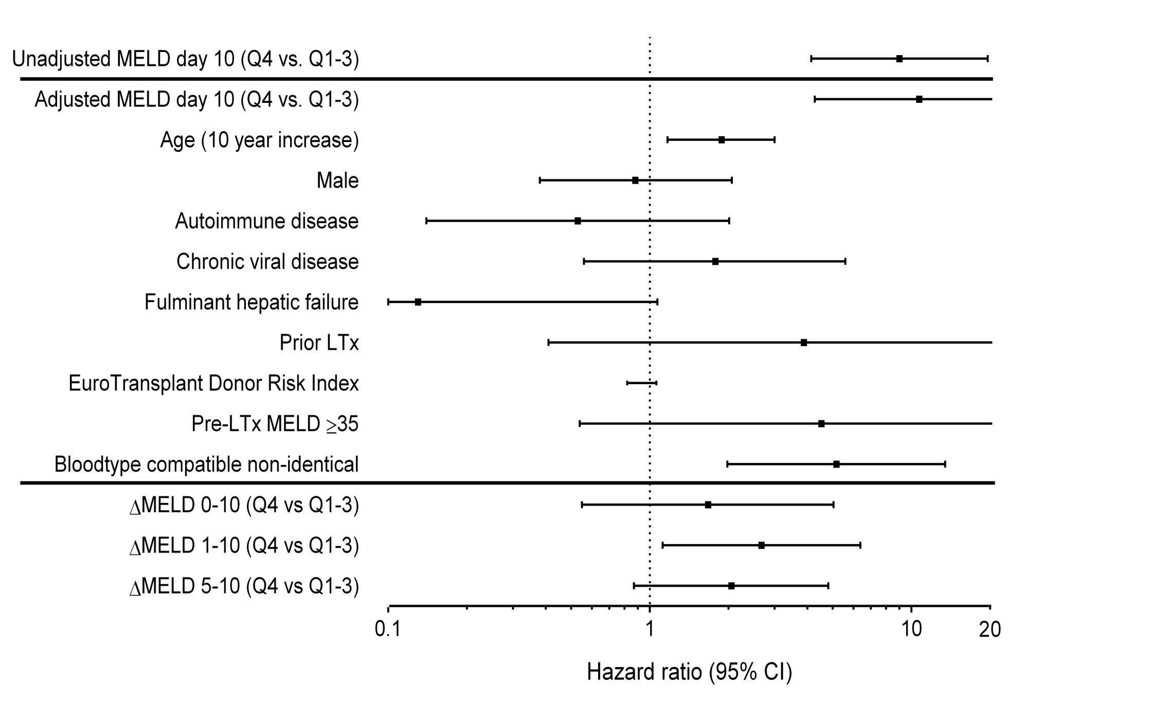
The adjusted MELD score performs equally good and ΔMELD from day 1-10 predicts graft failure
Notes:
Fremhæv donor risk index. Husk at sig de justeres. Nævn delta MELD om det rykker adjusted MELD.

Slide 11
Conclusions
The MELD score determined at day 10 post-LTx is a strong and independent predictor of 1-year mortality or re-LTx. Almost all patients who died or were re-transplanted had a day 10 post-LTx MELD >17.4.
Pre-LTx MELD score, donor quality and peri-LTx operative procedures failed to predict having a high day 10 post-LTx MELD score, suggesting that events within first few days after LTx determines having a day 10 post-LTx MELD score > 17.4.
These observations should be confirmed in an independent dataset, concerted actions to identify factors in the post-operative course that result in elevated day 10 post-LTx MELD score should be undertaken.
Notes:
Inden for den første uge efter transplantationen kan vi identificerer næsten alle dødsfald indenfor en uge, det er ikke de mest syge (pre-MELD) ej heller donor. Hvorfor giver tidlig allograftr dysfunction død efter måneder, måske kan der ikke gøres noget ved det.
Tilføj donor slide til spørgsmål. Tilføj komponent slide. Tilføj dødsårsag slide, tidsfaktorer.

Slide 12
Components of the MELD score
When each component is added individually to the multivariate model together with the MELD score.
  INR (HR 2.0, 95% CI: 0.8-4.8),
  Bilirubin (HR 0.9, 95% CI: 0.3-2.5)
  Creatinine (HR 0.9, 95% CI: 0.4-2.3).
Dialyse at day 10 – HR 2.1 (95% CI, 0.7-5.9)
  MELD day 10 (Q4 vs Q1-3) – HR 7.8 (95% CI, 2.8-22.2)

Slide 13
Donor characteristics
 | Survivors n = 216 (85%) | Death or Re-LTx n = 38 (15%)
ET-Donor Risk Index, median (IQ range) | 1.6 (1.3-1.9) | 1.8 (1.5-2.0)
Age, median years (IQ range) | 52 (39-60) | 54 (44-64)
Height, median cm (IQ range) | 172 (168-180) | 174 (168-180)
Weight, median kg (IQ range) | 73 (65-85) | 72 (66-83)
Male, n (%) | 100 (46 %) | 22 (58 %)
Mechanical support, median hours (IQ-range) | 24 (16-50) | 25 (18-36)
Donor warm ischemia, median min (IQ-range) | 45 (37-54) | 44 (40-56)
Cold ischemia, median min (IQ range) | 634 (525-763) | 690 (563-835)
Recipient warmischemia, median min (IQ range) | 54 (46-61) | 60 (50-69)
Donor diagnose, n (%)
Anoxia | 23 (11 %) | 3 (8 %)
Cerebrovascular accident | 154 (71 %) | 27 (71 %)
Trauma | 34 (16 %) | 5 (13 %)
Other | 5 (2 %) | 3 (8 %)
Bilirubin, median mikromoles/L (IQ range) | 9 (6-13) | 9 (6-12)
ALAT, median IU/L (IQ range) | 28 (17-51) | 33 (21-63)
Creatinine, median mmol/L (IQ range) | 67 (50-82) | 69 (46-88)

Slide 14
Change in the adjusted MELD after adding ΔMELD individually
ΔMELD day 0 to 10 - HR 1.8 (95% CI, 0.6-5.5)
  MELD day 10 (Q4 vs Q1-3) – HR 7.8 (95% CI, 2.6-23.8)
ΔMELD day 1 to 10 - HR 2.7 (95% CI, 1.1-6.4)
  MELD day 10 (Q4 vs Q1-3) – HR 7.3 (95% CI, 2.7-19.8)
ΔMELD day 5 to 10 - HR 2.0 (95% CI, 0.9-4.8)
  MELD day 10 (Q4 vs Q1-3) – HR 7.7 (95% CI, 2.9-20.3)

Slide 15
Immediate cause of death
 | Died after day 10 n = 25
Arterial thrombosis | 1 (4 %)
Cardiovascular disease | 2 (8 %)
Hemorrhage | 4 (16 %)
Liver failure | 1 (4 %)
Malignancy | 2 (8 %)
Neurological | 1 (4 %)
Septicemia and MODS | 9 (36 %)
Other infection | 5 (20 %)

